Slide 1
GPP Exam: Zombie AI

Slide 2
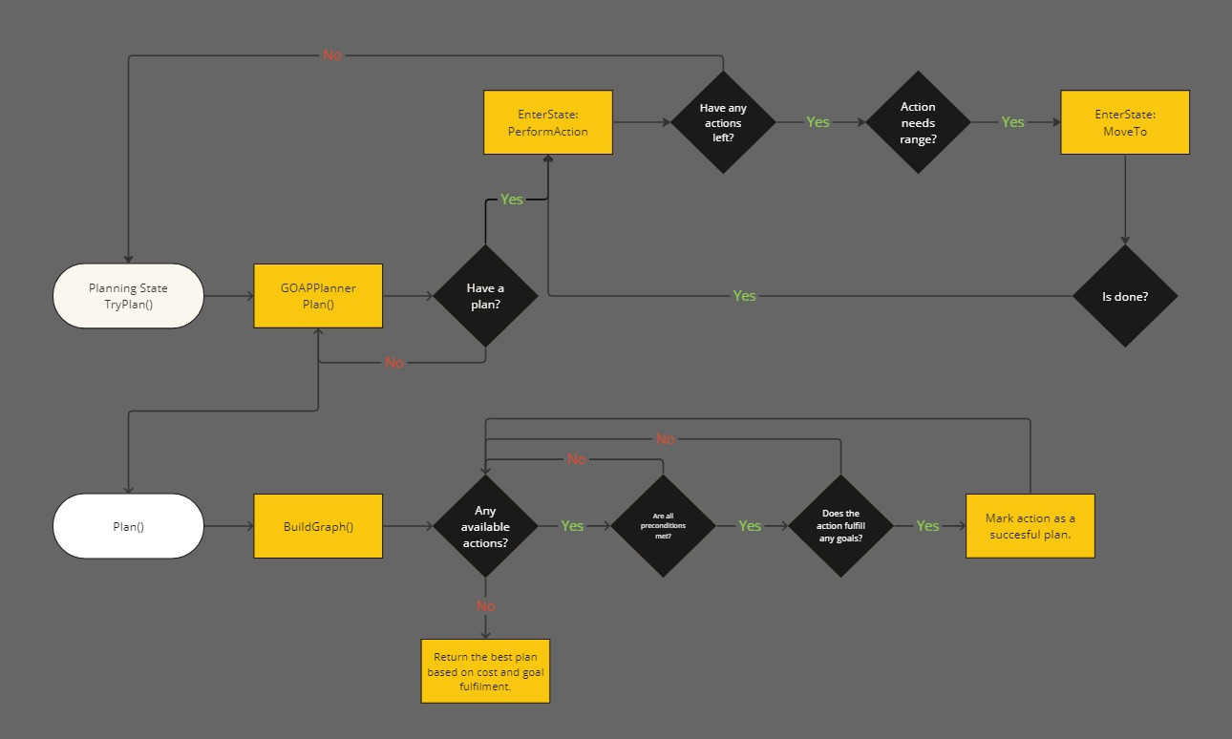
Decision Making
The agent uses a Finite State Machine (FSM) and a Goal Oriented Action Planner (GOAP) for decision making.
Once a plan is chosen and executed, we monitor for changes in the world that might make the agent want to create a new plan.

Slide 3
Enemy handling
When we see an enemy, GOAPPlanner builds a plan depending on whether the agent has any weapons or not. If the agent does have a weapon, they face the enemy and shoot it. If not, the plan will be to flee from the enemy, and the agent will run if they have enough stamina until it’s too low. Then they stop running to regenerate stamina and continue running when it’s high enough.
The agent stops fleeing after a certain amount of time, or when they see a house that they can search or an item that they can pick up.

Slide 4
Inventory
When the agent sees an item, GOAPPlanner may decide to pick up the item if we have room in the inventory. The agent picks up med kits and food only if we don’t already have them, so we always have room for weapons.
New items are added to the first available slot in inventory.
The agent has a short-term memory for items it has seen, allowing the agent to plan without needing to see the items at the moment.
We keep track of health and energy levels, and the agent uses the appropriate consumable when necessary.

Slide 5
Movement - Steering
The agent has two steering behaviors: seeking and wandering. Wandering is used with ExploreAction, when we have nothing else to do, and seeking is used when fleeing from or attacking an enemy or when the agent enters a house to search for items.

Slide 6
Movement - Exploration
The agent explores the world when there are no enemies or items in sight, so we don’t prioritize exploration over actions that directly contribute to the agent’s survival.
When exploring, the agent chooses destinations in a certain radius, and continues exploring until they have a new entity in FOV. Then we start building a new plan accordingly.
The agent keeps seen houses in a long-term memory, and categorizes them as searched and unsearched. This prevents the agent from detecting and searching the same house again when it’s already looted.
The agent doesn’t search houses if there’s no space in inventory.

Slide 7
High Score
My current highest score is 290 on release and 769 on debug (without the starter weapons).
Note: Turns out the timer doesn’t pause if we hit a breakpoint and keeps adding points to the score, which is why it’s much higher.
Issues I Had
- Enemies not being identifiable caused issues in the way I implemented a memory. Currently, when we have an enemy in FOV, memory does not know if it’s a new enemy or one we already recorded, so the GOAP can’t plan accordingly (e.g. While fleeing, the agent still looks around to see if there are items to pick up, but it can also see the enemy it’s fleeing from again, which makes it register it as a new threat and create a new plan when it doesn’t need to).
- It’s possible for the agent to get stuck at a house door, sometimes with an enemy also stuck next to it, blocking each other’s movement. Choosing random different destinations sometimes did not help since the agent still had to reach the same node on the navmesh to be able to get out.
- The agent did not manage to push the enemies away, so it’s possible to get surrounded by enemies against a wall. (Two enemies were enough to block all movement in my case).

